Slide 1

WAY TO ENTERPRISE
AWS
VTI ACADEMY
Author: duy.nguyenngoc1@vti.com.vn

Slide 2
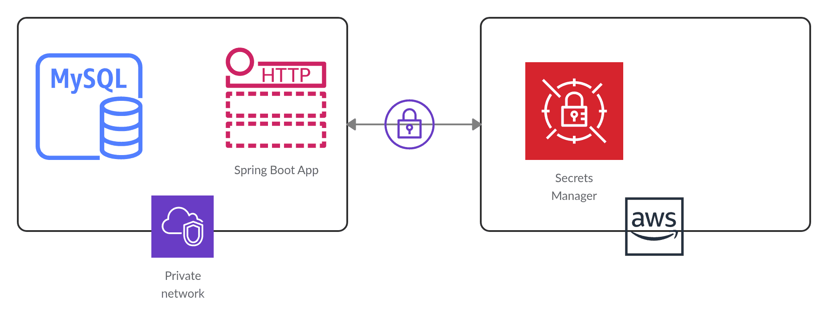
Secrets Manager Service
Allow to get secrets (username & password) through code (not hardcode directly in code)
Integration with Amazon RDS, Redshift…
Usecases: store sensitive information: Username & Password, License code, API key, …
Price: https://aws.amazon.com/secrets-manager/pricing
Tutorial: https://docs.aws.amazon.com/secretsmanager/latest/userguide/intro.html

Slide 3
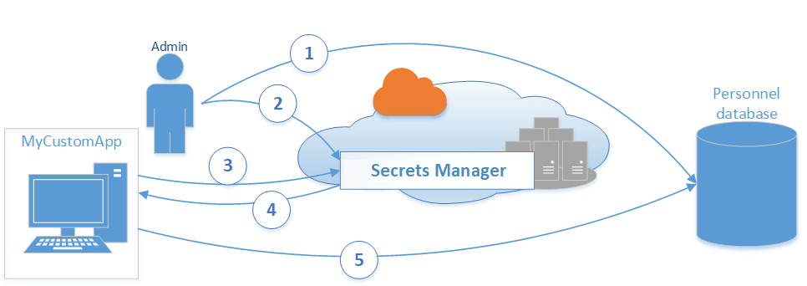
Secrets Manager Service
Flow
  Admin create database and config username & password (credential) using Secrets Manager for database
  Secrets Manager will encrypt and save the credential
  MyCustomApp wants to access the database, it will request to Secrets Manager to get username & password
  Secrets Manager will decrypt & return credential via HTTPS & TLS
  MyCustomApp gets credential and accesses database

Slide 4
Secrets Manager Service
Demo
  https://youtu.be/jgQaGhx_YaQ?t=499
  https://www.youtube.com/watch?v=Y3Gn_iP3FlE
  https://docs.aws.amazon.com/secretsmanager/latest/userguide/tutorials.html

Slide 5
Assignment
  Self-practice

Slide 6
Secrets Manager Service
Components
  Secret

Slide 7
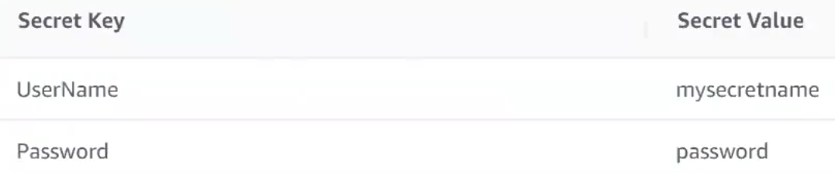
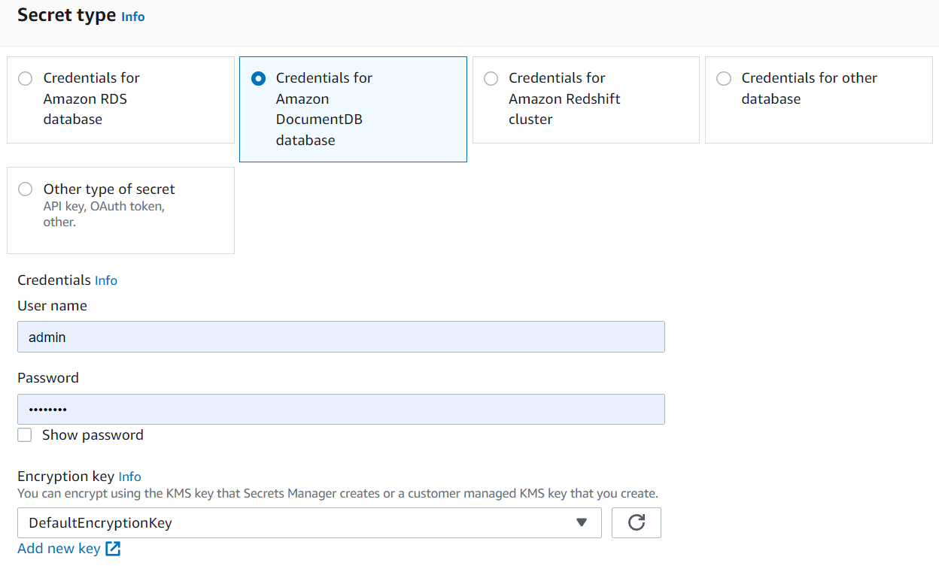
Secrets Manager Service
  Secrets
    Key-value format
    Types
      Credentials for RDS database
      Credentials for on-premises database
      Credentials for Redshift cluster
      Other type of secrets (Ex: API Key, token, …)

Slide 8
Secrets Manager Service
    Suppport encrypt secret with KMS
    Policy with IAM Service
    Replicaset Secret in other region
    Automatic rotation: 30/60/90 days, Lambda Function
    Support application: Java, JS, C#, Python, PHP, Go, Node.js…

Slide 9
Secrets Manager Service
Features
  Set secret through runtime programming
  Save many different type secrets (RDS, Redshift, custom, ...)
  Encrypt secret
  Automatic rotate secret
  Secret policy

Slide 10
Q & A
Copyright © VTI Academy All Rights Reserved

